Slide 1
Next.js Essentials
Overview of Next.js
Creating and running a Next.js application
Understanding the application
Annex
Modular CSS

Slide 2
Section 1: Overview of Next.js
What is Next.js?
Key differences between Next.js and vanilla React
Next.js documentation

Slide 3
What is Next.js?
Next.js is a React framework for building full-stack web applications
Next.js utilizes many familiar React techniques and concepts, but often with a different twist…
Functional components
JSX / TSX syntax
Routing
Effect hooks
Etc.

Slide 4
Key Differences between Next.js and Vanilla React
Routing
Next.js used file-based routing - each folder is a route
Component rendering
Next.js can render components on the client or server
Client components handle UI events and hold mutable state
Server components can easily access server-side resources
Data fetching
Server components can fetch and cache data at the server

Slide 5


Next.js Documentation
The Next.js documentation is very good actually
See https://nextjs.org/docs
Make sure you use the docs for App Router (current)
Don't use the docs for Pages Router (legacy)
✅
🚫

Slide 6
Section 2: Creating & Running a Next.js Application
Overview
Creating an application
Reviewing the application
Running the application in dev mode
Viewing the application
Using hot reloading
Building/running the application in production

Slide 7
Overview
The recommended way to create a Next.js application is via the create-next-app tool
Scaffolds a complete template application
Generates appropriate config files
Reinforces best practices for file names, folders, etc.
To install create-next-app on your machine (requires Node.js 18.17 or later):
npm install create-next-app@latest
7

Slide 8
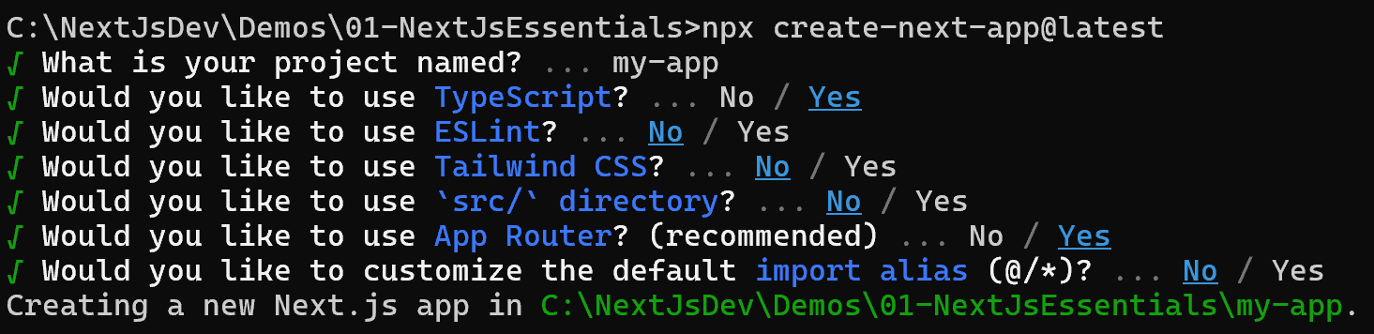
Creating an Application
You can use create-next-app in interactive mode:
It asks you a series of questions about your new app
We suggest the following answers…
npx create-next-app@latest
8

Slide 9
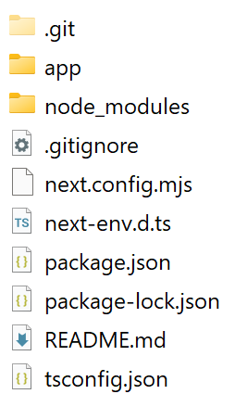
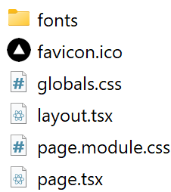
Reviewing the Application
Here's the application generated by create-next-app:
app folder
All your code
9

Slide 10
Running the Application in Dev Mode
To run the application in dev mode:
What this does:
Compiles the application in memory
Runs it in a dev server on http://localhost:3000
For full details about command-line options, see:
https://nextjs.org/docs/app/api-reference/next-cli
npm run dev
10

Slide 11
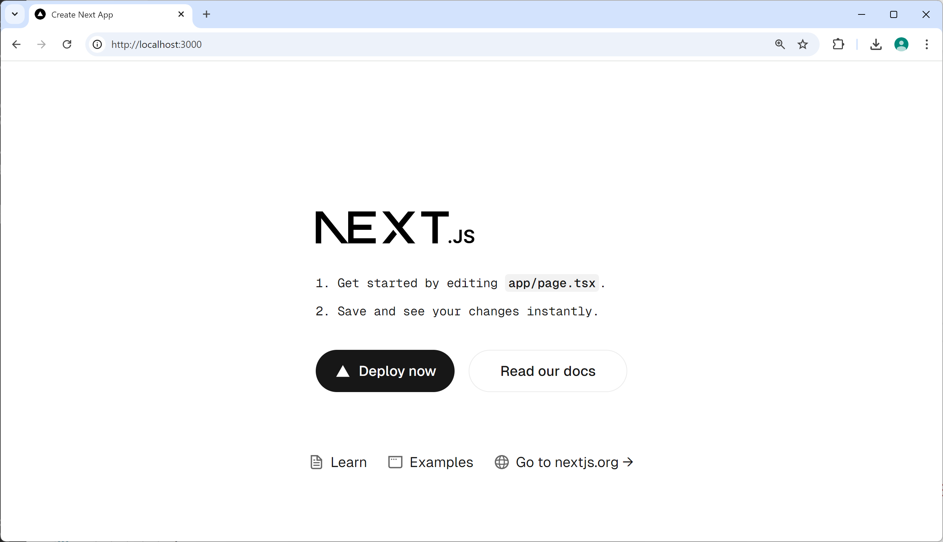
Viewing the Application
Open a browser and go to http://localhost:3000
11

Slide 12
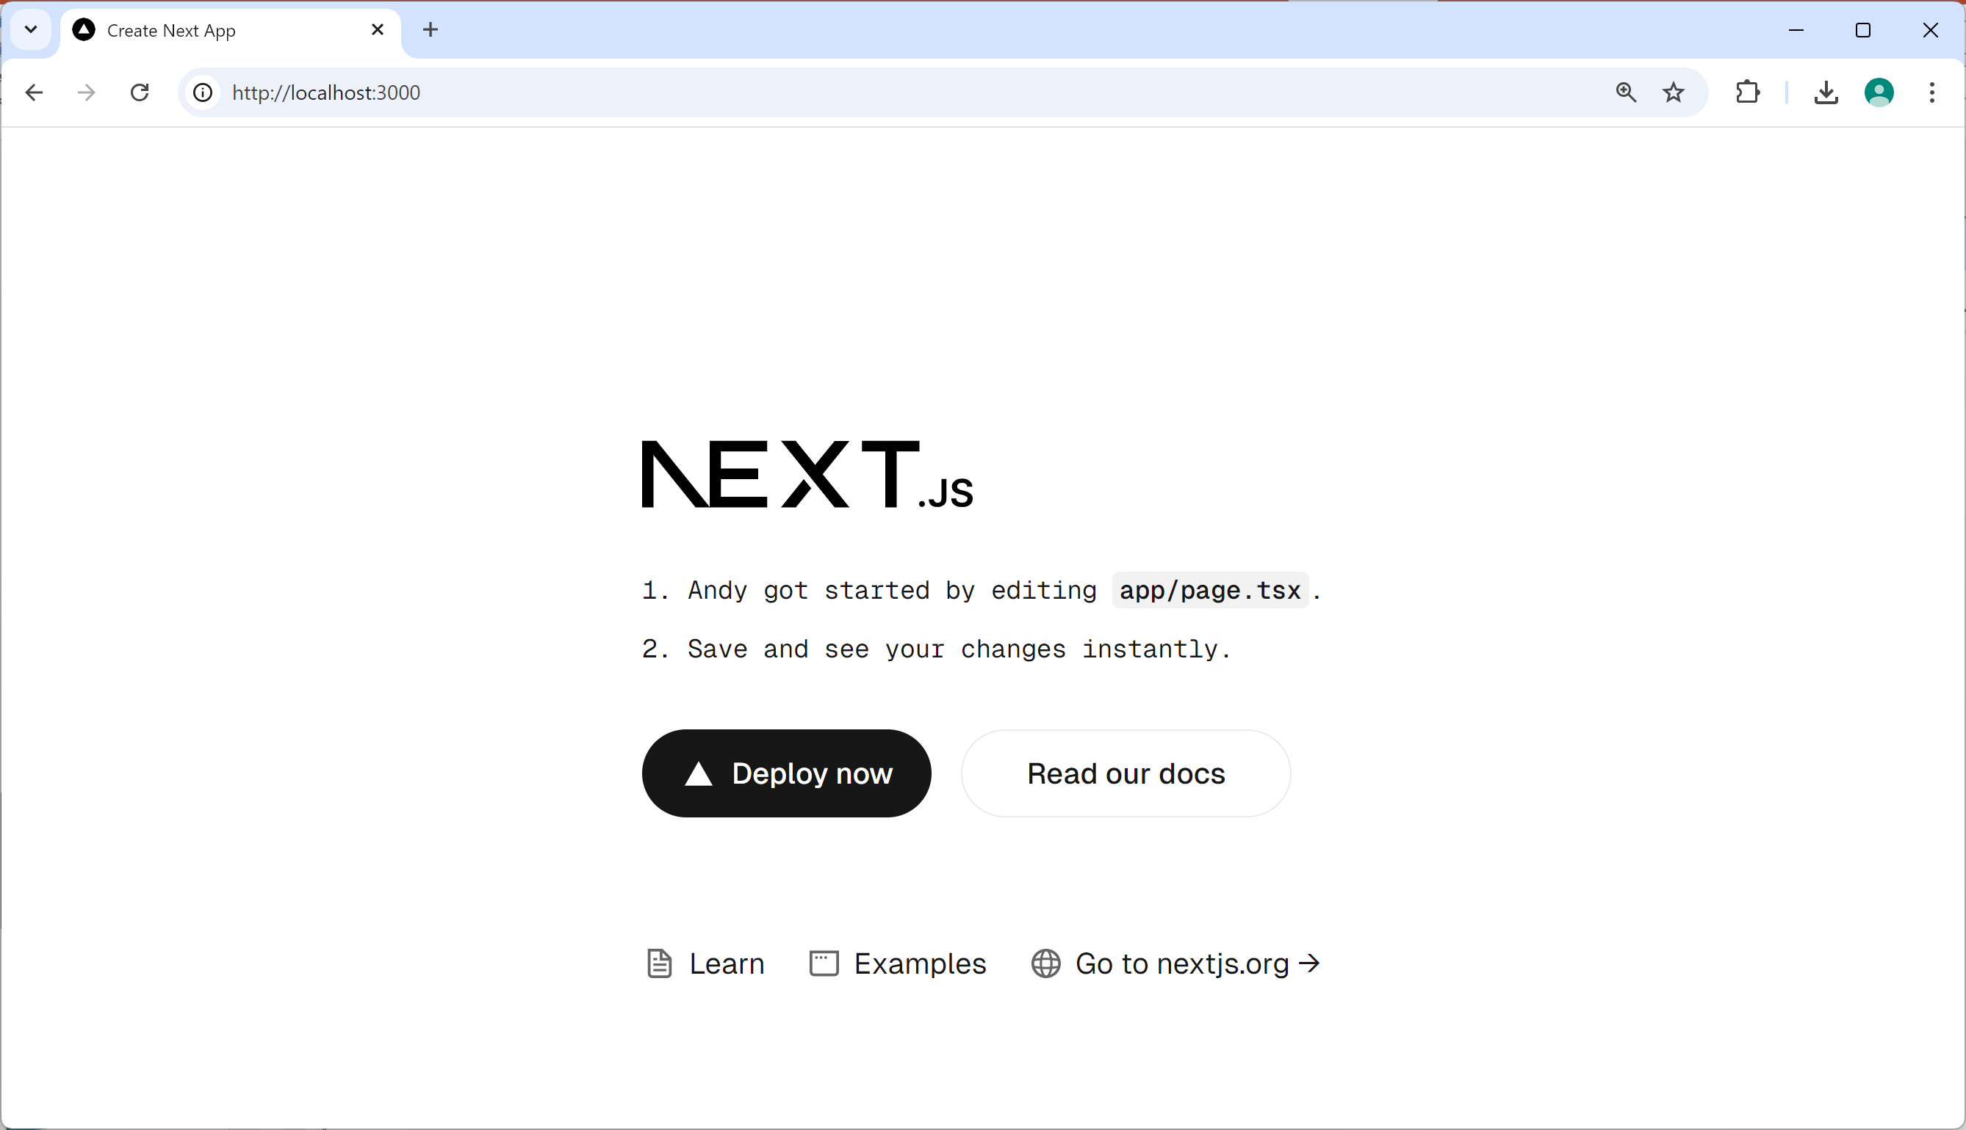

Using Hot Reloading
If you modify the app, it will be automatically reloaded
12

Slide 13
Building/Running the Application in Production
To build the application optimized for production:
To run the production-ready application on Node.js:
npm run build
npm run start
13

Slide 14
3. Understanding the Application
Recap of the application structure
File-based routing
Understanding page.tsx
Layouts
Understanding the root layout
14

Slide 15
Recap of the Application Structure
Here's a reminder of the application structure:
app folder
All your code
15

Slide 16
File-Based Routing
Next.js uses file-based routing
Each folder represents a different route
When the user navigates to a route:
Next.js renders page.tsx in the relevant folder
When the application starts up:
The route is /
This is represented by the /app folder
Thus Next.js renders /app/page.tsx
16

Slide 17
Understanding page.tsx
A page.tsx file defines a React functional component and exports it as the default export
Also notice the use of modular CSS stylesheets
See Annex for more details
import styles from "./page.module.css";
…
export default function Home() {
return (
<main className={styles.main}>
…
</main>
);
}
/app/page.tsx
17

Slide 18
Layouts
Next.js has the concept of layouts
A layout defines a common UI, shared by multiple routes
Inside the layout, the current route content is rendered
Layout defines common UI
Current route content is rendered here
18

Slide 19
Understanding the Root Layout
Every Next.js application must have a root layout
Defined in /app/layout.tsx
Here's a simplified version…
Notes:
The root layout must define <html> and <body> tags
You can also define nested layouts for lower-level routes
export default function RootLayout({children}) {
return (
<html>
<body>{children}</body>
</html>
);
}
/app/layout.tsx
19

Slide 20
Summary
Overview of Next.js
Creating and running a Next.js application
Understanding the application

Slide 21
Annex: Modular CSS
Overview
Defining a modular stylesheet
Using a modular stylesheet

Slide 22
Overview
Modular CSS enables you to define stylesheets that only apply to one module (file)
Modular CSS is good practice and is widely used
Enables you to define per-component styles
Don't interfere with styles in other components

Slide 23
Defining a Modular Stylesheet
To define a modular stylesheet:
Name the stylesheet xxx.module.css
Define CSS classes in the stylesheet
Example:
Under the covers, the CSS class name will be mangled
E.g. page_main__5f+jZ
.main {
…
}
page.module.css

Slide 24
Using a Modular Stylesheet
To use a modular stylesheet:
Import the stylesheet and give it a programmatic name
Access CSS classes via the programmatic name
Example:
import styles from './page.module.css'
export default function Home() {
return (
<div className={styles.main}>
…
</div>
);
}
page.tsx

